Slide 1
Government Shutdowns
Ahmeda - Amrit - Greg

Slide 2
Agenda
Shutdown?! .. Facts
How does the S&P 500 respond to a government shutdown?
Impact of Government Unification
Public view (Approval ratings)

Slide 3
Data Sources
S&P 500 Historical Data (1976-2019) - Source: Yahoo Finance
Party Control 1933-2010 - Source: Southeast Missouri State University
Party Control 2010-Present - Source: Party Division of US Congress-Wikipedia
Shutdowns Data - Source: Vox
Former Presidents’ Job Approval Ratings - Source: The American Presidency Project
President Trump’s Job Approval Ratings - Source: Gallup

Slide 4
Some Shutdown Facts:
There was a total of 21 shutdowns occurring from 1976 (when the shutdown era started) to the present.
13 shutdowns occurred with a Republican president while 8 occurred with a Democratic president.
The majority of the shutdowns (15 of them or 71%) occurred between 1976 and 1990.
There was a period from 1995 till 2013 when no shutdowns occurred under both Democratic & Republican presidents.
President Reagan has the all-time high in shutdowns with 8 of the 21 occurring during his presidency.

Slide 5
Data Cleanup
S&P 500 Historical Data
Cleaning out dates, leaving only those during a shutdown
Needed to account for days where the market was closed
Approval Ratings Data
Approval ratings data came for each president separately
Did not follow a particular timeline (i.e. Polls taken every couple days, weeks or in some cases missing)
Date formats in some cases appeared this way: 2013 feb 27-mar 3
Some datasets came with multi-level column indexes and missing values
Some datasets were missing recent data that we needed for our analysis. Therefore, we had to append different sources together

Slide 6
S&P 500 Performance Visualizations

Slide 7
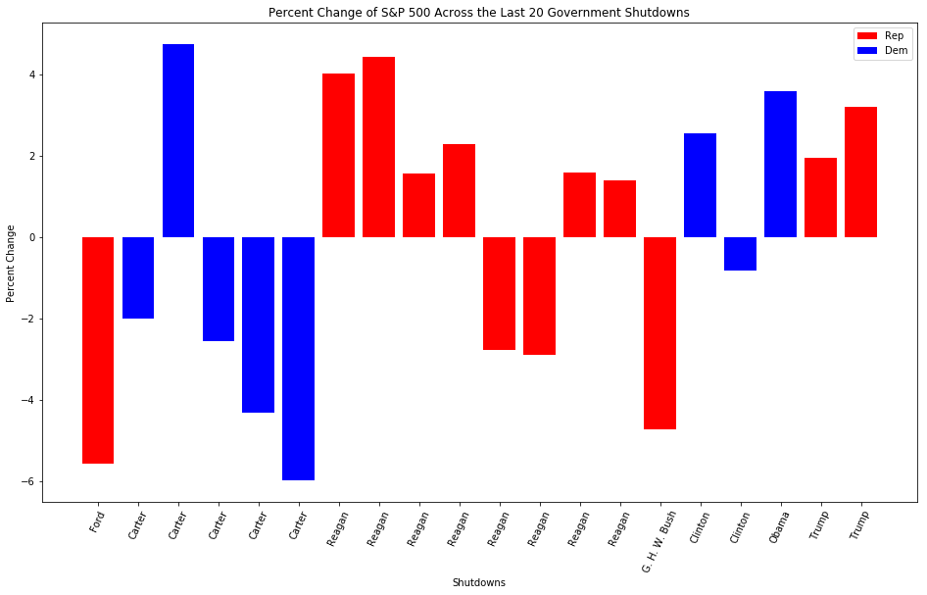

Slide 8
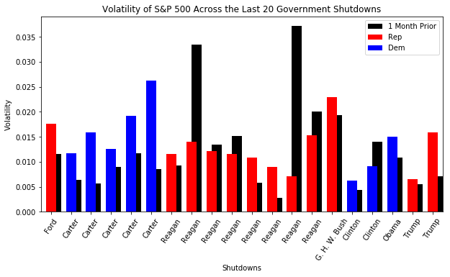

Slide 9
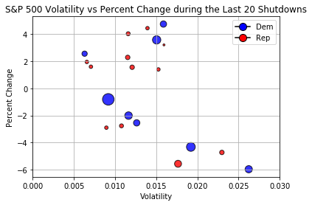

Slide 10
Government Unification & Public View

Slide 11
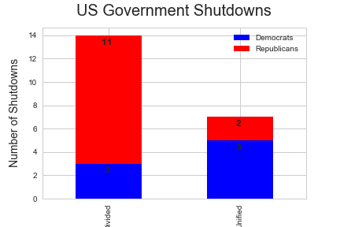
Party Division

Slide 12
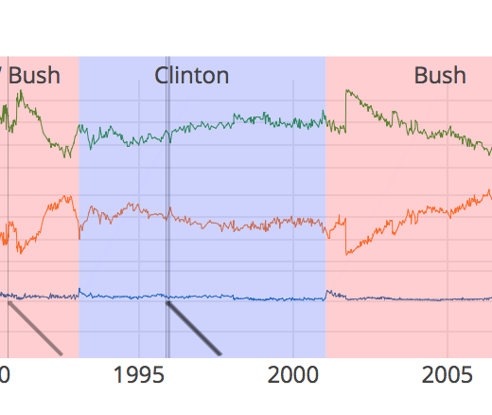
Job Approval Ratings since ‘76.
Plotly Link

Slide 13
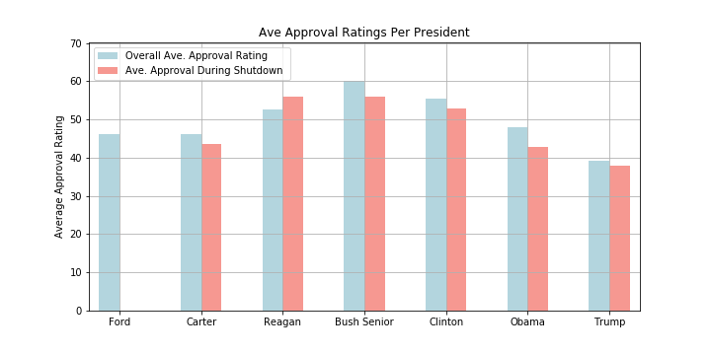
President: Average Approval Rating w/ Average Approval Rating During Shutdown

Slide 14
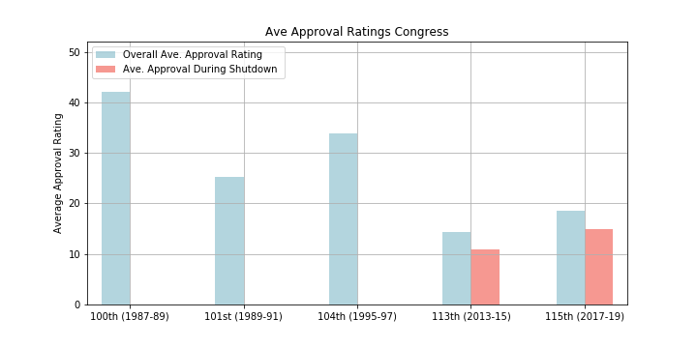
Congress
115th: 3 SDW
113th: 1 SDW
104th: 2 SDW
101st: 1 SDW
100th: 1 SDW

Slide 15
Acknowledgement of Limitations
In some cases, ranges of shutdowns were missing for presidents’ approval ratings
Congress approval ratings become less available as we go back in time (in some cases months without data)
Also, other factors may affect a president’s approval ratings, therefore causing the decline or increase in his/her ratings. (President Bush case)
Scandal, Economy, War/Peace etc..
Errors in Polling techniques
And… A lot more...

Slide 16
Summary
For S&P 500, there seems to be little effect on the market from the shutdown. Volatility remains fairly constant, and percent change moves between 2-3% in either direction.
A shutdown is twice as likely to occur when the government is divided.
There seems to be a trend for approval ratings every time a shutdown takes place.

Slide 17
Q&A

